Slide 1
Lecture 26
Acousto-optic effect

Slide 2
Effect of Strain
e-cloud
e-cloud
Ky
Apply Strain
Kx
Kx
Ky
U(x,y)
U(x,y)
0
x,y
0
x,y
-U₀
-U₀

Slide 3
Strain tensor
y
u(x,y,z)
v(x,y,z)
x
Tension/Compression
Shear
u, v, and w are the displacements from equilibrium position along x, y and z respectively.

Slide 4
Changes in index ellipsoid
Introduce one-index notation for the strain tensor
Introduce 6x6 strain optic tensor P
Changes in the impermeability tensor
Original index ellipsoid
New index ellipsoid

Slide 5
Examples of strain optical (photoeastic) tensor
Isotropic media
Just two independent components
In Fused Silica
In water
Consider longitudinal acoustic wave propagating along z direction in isotropic medium
Impermeability tensor
Medium becomes uniaxial

Slide 6
Examples of strain optical (photoelastic) tensor
In LiNbO₃
8 independent components
Consider transverse (shear) acoustic wave propagating along z direction and polarized along y direction in LiNbO₃
Ellipsoid equation
Medium becomes biaxial with principal axes rotated in yz plane

Slide 7
Photoelastic coefficients at λ=632nm

Slide 8
Light diffraction on acoustic waves (phonons)
Raman-Nath diffraction
Light
wave
Acoustic wave
Bragg Diffraction
z
+2 order
Acoustic wave
Λ=2π/K
Light
wave
+1 order
+1 order
0 order
-1 order
-2 order
0 order
Diffracted Light
L
Acoustic Amplitude
and Index Change
S,Δn
interaction length
Example: SiO₂
Raman-Nath diffraction (Multiple diffraction orders)
Two regimes
Bragg diffraction (Single diffraction order)

Slide 9
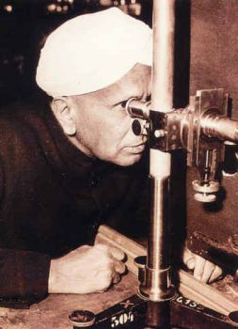
Raman-Nath diffraction
Acoustic wave produces moving refractive index grating
For thin plate (small L) phase delay is
Incident field
Transmitted field is
drop
Expand into the Fourier series using properties of Bessel function
1888-1970

Slide 10
Raman-Nath diffraction
0-order term
The wave-vector along x must change (a bit)
+1-order term at frequency ω+Ω
(-1)-order term at frequency ω-Ω
k⁻
k
θ1
K
θ−1
K
k⁺
k
Direction of propagation
Energy and momentum
conservation
Diffraction grating

Slide 11
Raman-Nath diffraction
H
Diffraction angle
k
θm
mK
k⁺
The magnitude of m-th maximum is determined by
If Δϕ=2.405 all the light is diffracted
If Δϕ=1.85- intensity of the 1st order reaches maximum 34%
1
For small Δϕ<<π/2
0.8
0.6
Diffraction efficiency into the first order
0.4
0.2
Acoustic wave intensity
0
0
2
4
6
8
10
Acoustic wave Power
Figure of merit

Slide 12
Raman Nath modulator
Light
wave
Acoustic wave
+1 order
0 order
stop
-1 order
L
Problem:
Limited bandwidth

Slide 13
Bragg diffraction
Acoustic wave
Light
wave
+1 order
k₊
Wave equation without acoustic wave is
θ
x
Has a solution
0 order
k
z
k₋
-1 order
In the presence of acoustic wave
Obviously terms with frequencies are generated as light propagates

Slide 14
Bragg diffraction
Acoustic wave
Light
wave
Look for the solution in the form
A_{m} –slowly variable amplitude
+1 order
k₊₁
θ
x
0 order
k
z
k₋₁
Substitute into the wave equation
-1 order
These
2 will cancel out
Now equalize the terms with the same time dependence exp[-j(ω+mΩ)t]

Slide 15
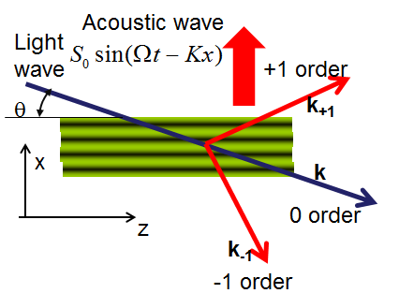
Bragg diffraction
The terms with the same time dependence exp[-j(ω+mΩ)t]
are the terms with A_{m.} on the l.h.s. and terms with A_{m+1} and A_{m-1} on the r.h.s.
Coupling strength
Introduce wave vector mismatch
Obviously solution grows linearly only when Δk~0 otherwise it oscillates as sinc function. Clearly no more than a single wave vector mismatch can be equal to zero simultaneously . Let us say the very first one, between 0 and +1 order
θΒ
z
Bragg condition
or
Acoustic wave creates a moving multilayer reflector

Slide 16
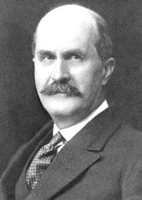
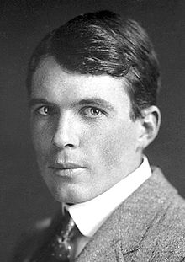
Bragg’s Law
1862-1942
1890-1971
W.H.Bragg
W.L.Bragg
θΒ
z
Bragg condition
or

Slide 17
Coupled waves equations
Acoustic wave
Light
wave
+1 order
θ
k₊₁
x
k
z
0 order
New variables
Looking for the solution:
The determinant must be equal to zero
Characteristic equation

Slide 18
Power balance
Boundary conditions:
P
1
P₀
Power transfer
P₊
z
Complete power transfer is possibly only when Δk=0
P
1
P₀
P₊
z

Slide 19
Modulation efficiency and speed
P₀
Complete power transfer-100% modulation
P₊
z
L
Example: TeO₂
for small acoustic powers
same as Raman Nath
Modulation speed: limited by the sound transit time across the beam waist w₀
If

Slide 20
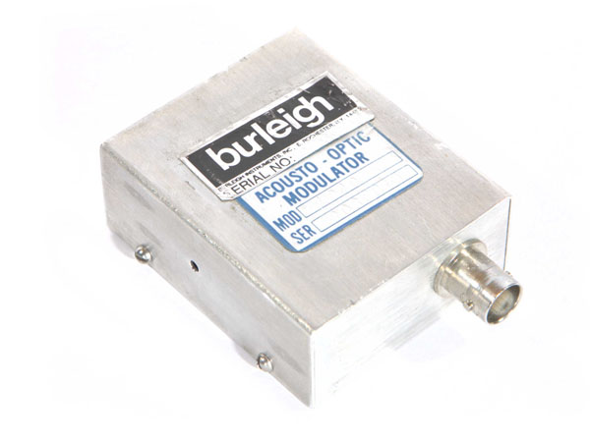
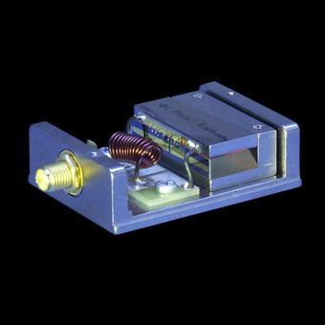
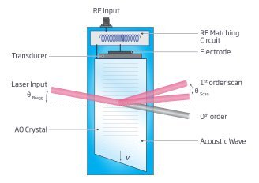
Acousto-optic modulators and deflectors
By changing RF frequency one can change deflection angle
Of course there is a limit to deflection angel because eventually one cannot get good momentum matching

Slide 21
Collinear interaction
z
Acoustic wave
y
x
LiNbO₃
W
H
L
This off-diagonal element couples extraordinary wave with ordinary wave with wavevector
mismatch
For collinear propagation

Slide 22
Acousto-optic tunable filter
Optical frequency at which the wave vectors are matched
Then at frequency
Length and power are adjusted for complete power transfer (polarization rotation) at
By changing acoustic frequency we can select optical frequency within Δν

Slide 23
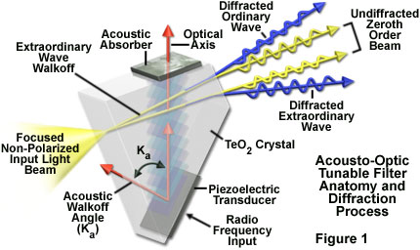
Non-collinear AOTF

Slide 24
Acousto-optic spectrum analyzer

